Slide 1

Curriculum Vitae
Nama : Muhammad Alamsyah Aziz, dr, SpOG(K), KIC, M.Kes
Tempat/tgl lahir : Palembang, 3 Januari 1972
Alamat rumah : Jl. Mayang Padmi no 3 Tatar Mayang Sunda
Kota Baru Parahyangan – Padalarang – Jawa Barat
Pekerjaan : Dokter spesialias Obstetri dan Ginekologi Konsultan Fetomaternal
Divisi Kedokteran Fetomaternal Dept OBGIN FK UNPAD/RSHS Bandung.
Email : alamsyahaziz9119@gmail.com
HP/Telpon : HP. 08122178711 Rumah 022-86814743 Kantor 022-2032530
Riwayat Pendidikan :
1. Pendidikan Dokter Umum, tahun 1997
2. Spesialis Obstetri dan Ginekologi FK UNPAD/RSHS Bandung, 2006
3. Konsultan Fetomaternal FK UNPAD/RSHS Bandung, 2010
4. Magister Kesehatan FK UNPAD/RSHS Bandung, 2006
5. Pendidikan Konsultan Intensive Care FK UNPAD/RSHS Bandung, 2014
6. Fetal Invasive and Prenatal Diagnostic Course, Leiden University, Amsterdam 2011
7. Diploma in Minimal Access Surgery (DMAS), WLH, India, New Delhi 2011
8. Fellowship in Fetal therapy and Maternal Intensive care, Catholic University of Korea, Seoul 2012
9. Program Pendidikan Doktor (S3) Universitas Padjadjaran Bandung, 2014-sekarang

Slide 2
Curriculum Vitae
Riwayat Pekerjaan :
1. Dokter PTT Kepulauan Riau, 1998-2001
2. Asisten (Residen) Dept OBGIN FK UNPAD/RSHS Bandung 2002-2006
3. Staf Sekjen Depkes RI ditugaskan di RSUD JAMPANG KULON-Sukabumi 2006-2008
4. Staf Pengajar Program D3/S2 Kebidanan FKUP/STIKES Dharma Husada Bandung, 2007-sekarang
5. Staf OBGIN FK UNPAD/RSHS Bandung, 2008-sekarang
6. Kepala Gedung Diagnostik/Cardiac Senter RSHS, 2015 sd sekarang
Editor/Kontributor/penulis buku:
1. Buku Ajar Kebidanan, Kontributor, Penerbit Balai Pustaka FKUI, Jakarta, 2008
2. Buku Penatalaksanaan Abortus Berulang, Kontributor, Penerbit PT Rafika Bandung, 2009
3. Buku Ajar Kandungan, Kontributor, Penerbit Balai Pustaka FKUI, Jakarta, 2010
4. Buku Prematuritas, Kontributor, Penerbit PT Rafika Bandung 2010
5. Buku Penatalaksanaan Kehamilan Multifetus, Kontributor, Penerbit PT Rafika Bandung, 2010
6. Buku Ajar Ultranonografi Obgin, Kontributor, Penerbit Sagung Seto Bandung, 2011
7. Buku Obstetri Emergensi, Editor dan Kontributor, Penerbit Sagung Seto Bandung, 2011
8. Buku Ajar Obstetri Patologi, Kontributor, Penerbit EGC Jakarta, 2013
9. Buku Diagnosis Prenatal, Editor & Kontributor, Penerbit Sagung Seto Bandung 2014
10.Buku Penatalaksanaan Intensif Obstetri, Kontributor, Penerbit Sagung Seto Bandung 2015
11.Buku Ajar Obstetri Intervensi, Alih Bahasa Kontributor, Penerbit Sagung Seto Bandung 2015

Slide 3
Prevention of Preterm Delivery: Current challenges and Future Prospects
Muhammad Alamsyah Aziz
Maternal Fetal Medicine Division
Obstetric and Gynecologyc Department
Faculty of Medicine Padjadjaran University
Hasan Sadikin General Hospital Bandung
Jawa Barat - Indonesia

Slide 4
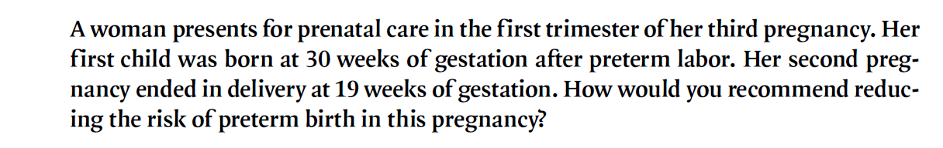

Slide 5
INTRODUCTION
Preterm birth is one of the most significant contributor to neonatal morbidity and mortality(Tepper,2012)
Preterm Birth (PTB) : < 37 weeks or 259 days
Globaly, 28% of 4 million annual neontal death are directly attributable to PTB
99 % in developing country
Incidence : 9-10% to 15 million babies delievered (Requiejo,2010)
MDGs 4 : require focused anttention on PTB

Slide 6
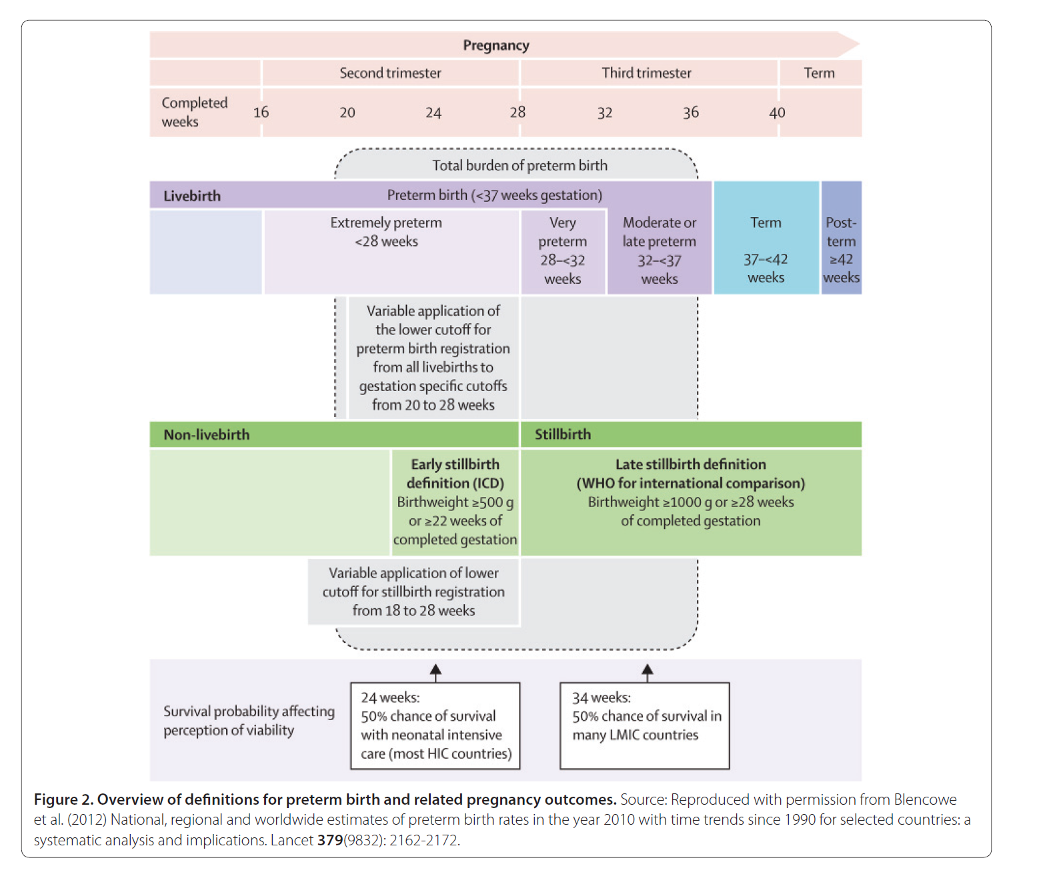
Overview of Definitions for preterm and
Related Pregnancy Outcomes
Blencowe et al. Reproductive Health 2013, 10(Suppl 1):S2

Slide 7

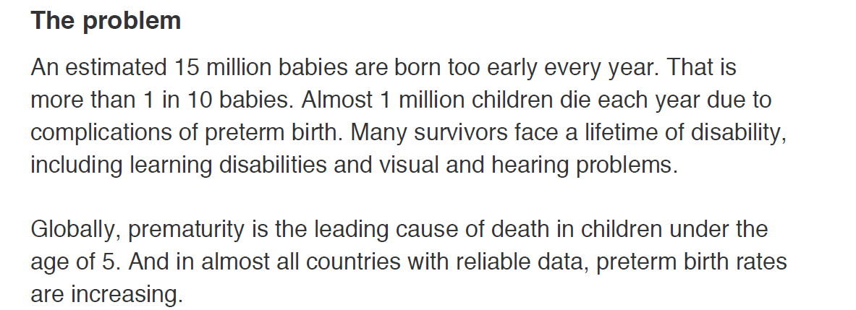

Slide 8
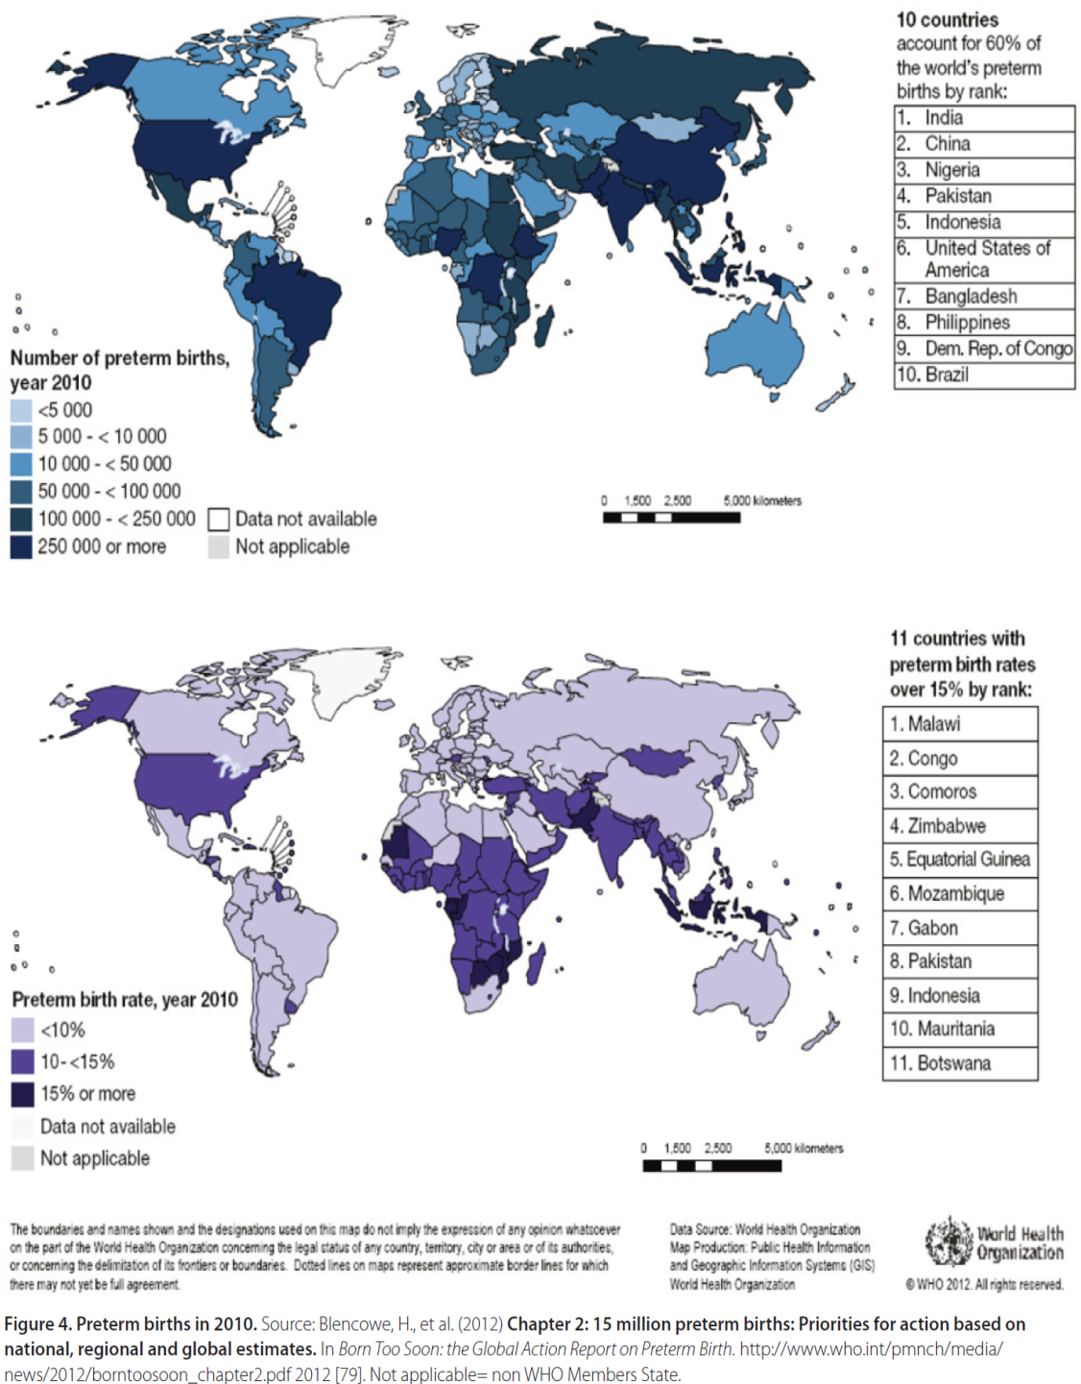

Slide 9
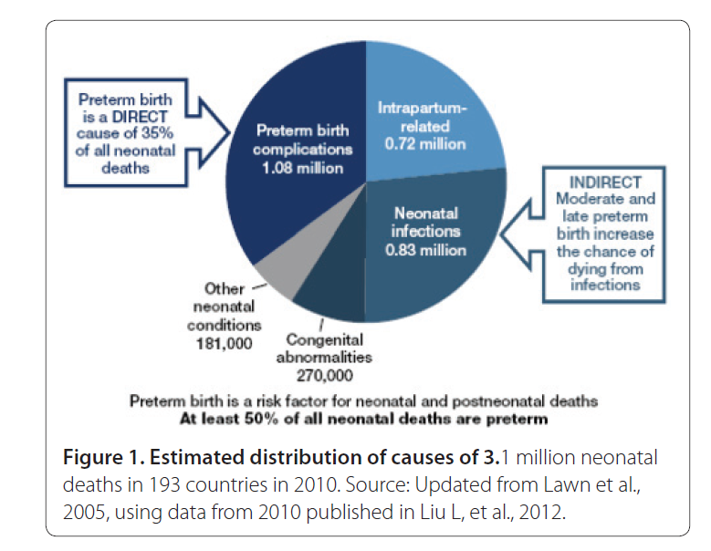
Causes of Neonatal Death in The World
Blencowe et al. Reproductive Health 2013, 10(Suppl 1):S2

Slide 10
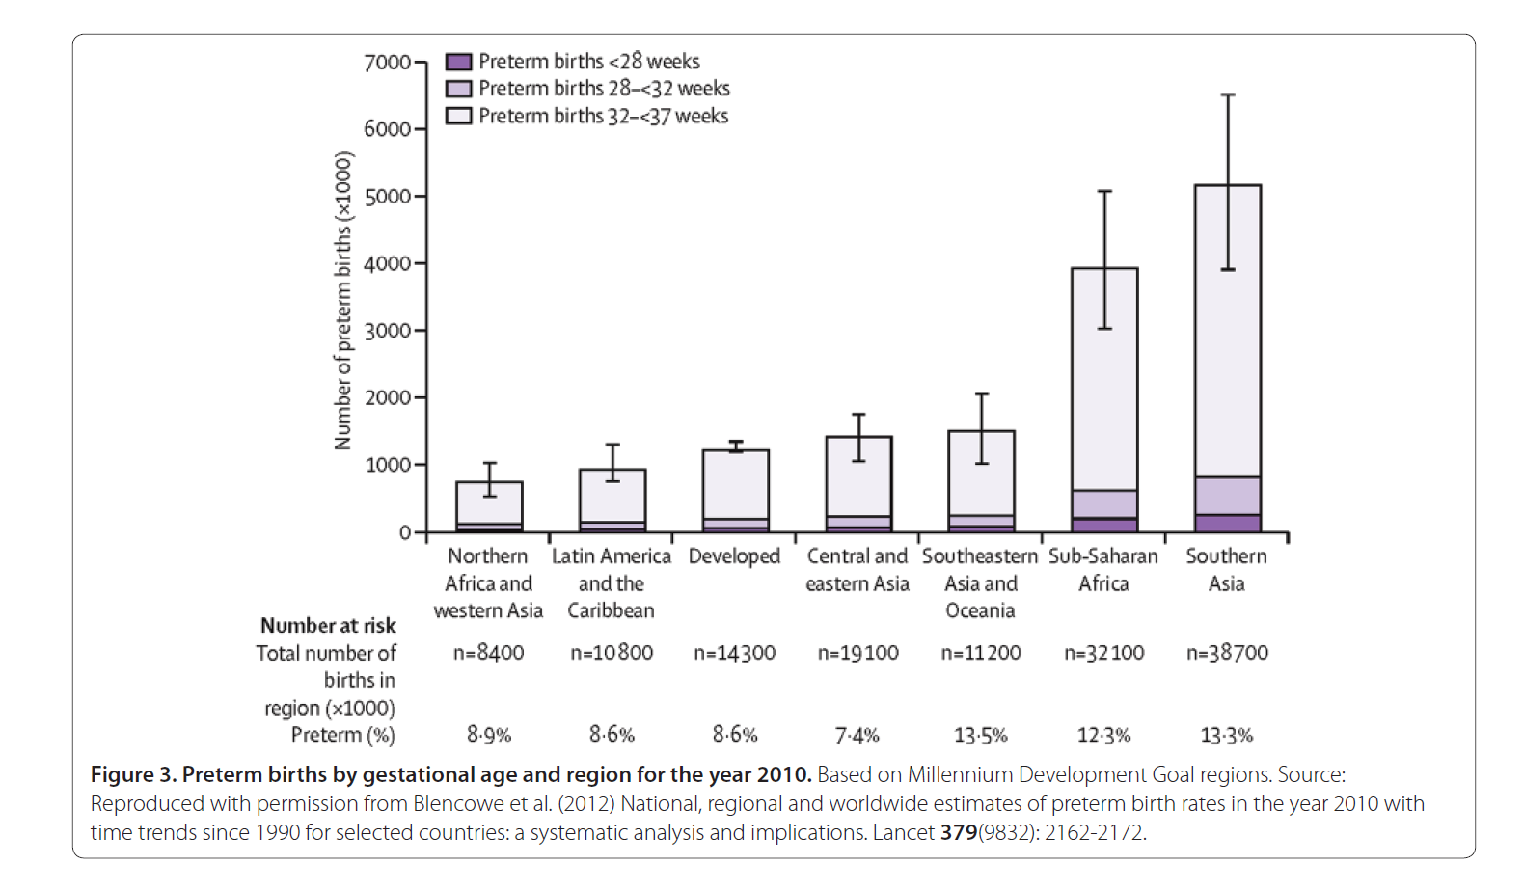
Preterm Birth by Country/Gestational Age
Lancet 379(9832): 2162-2172

Slide 11
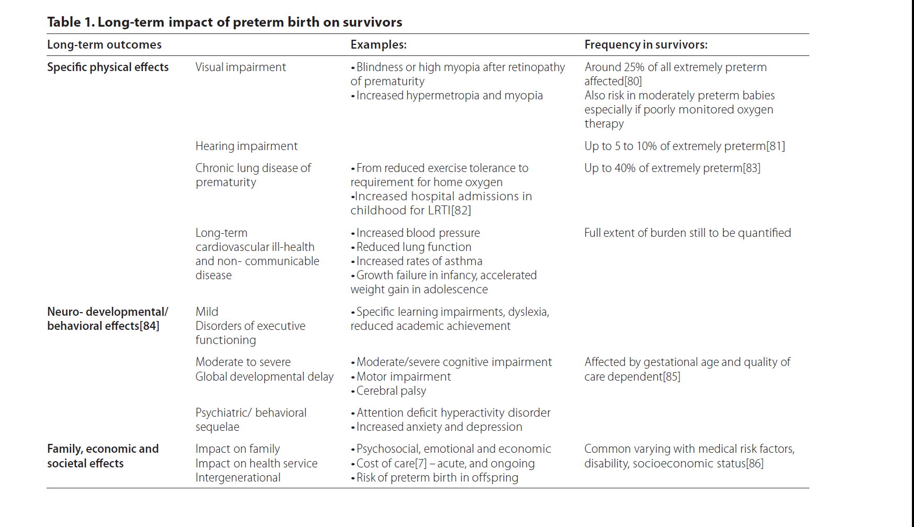
Long Term Impact Of Preterm Birth On Survivors
Blencowe et al. Reproductive Health 2013, 10(Suppl 1):S2

Slide 12

Reducing of Neonatal Morbidity and
Sequences of Death- Through preventing the sequences of parturition
SOFTENING- RIPENING- DILATION- REPAIR
ANTICIPATE/REACT--

Slide 13


FACTORS ASSOCIATED WITH A RISK OF PRETERM BIRTH MAY BE IDETIFIED BEFORE PREGNANCY,AT CONCEPTION AND DURING PREGNANCY
PRENATAL CARE : AS EARLY AS POSSIBLE ( 1St TRIMESTER)→ IDENTIFIED THE RISKS
THE SIGNS AND SYMPTOMS OFF PRETERM LABOR SHOULD BE EDUCATED
SCREENING FOR WOMAN AT RISKS SHOULD BE DONE

Slide 14
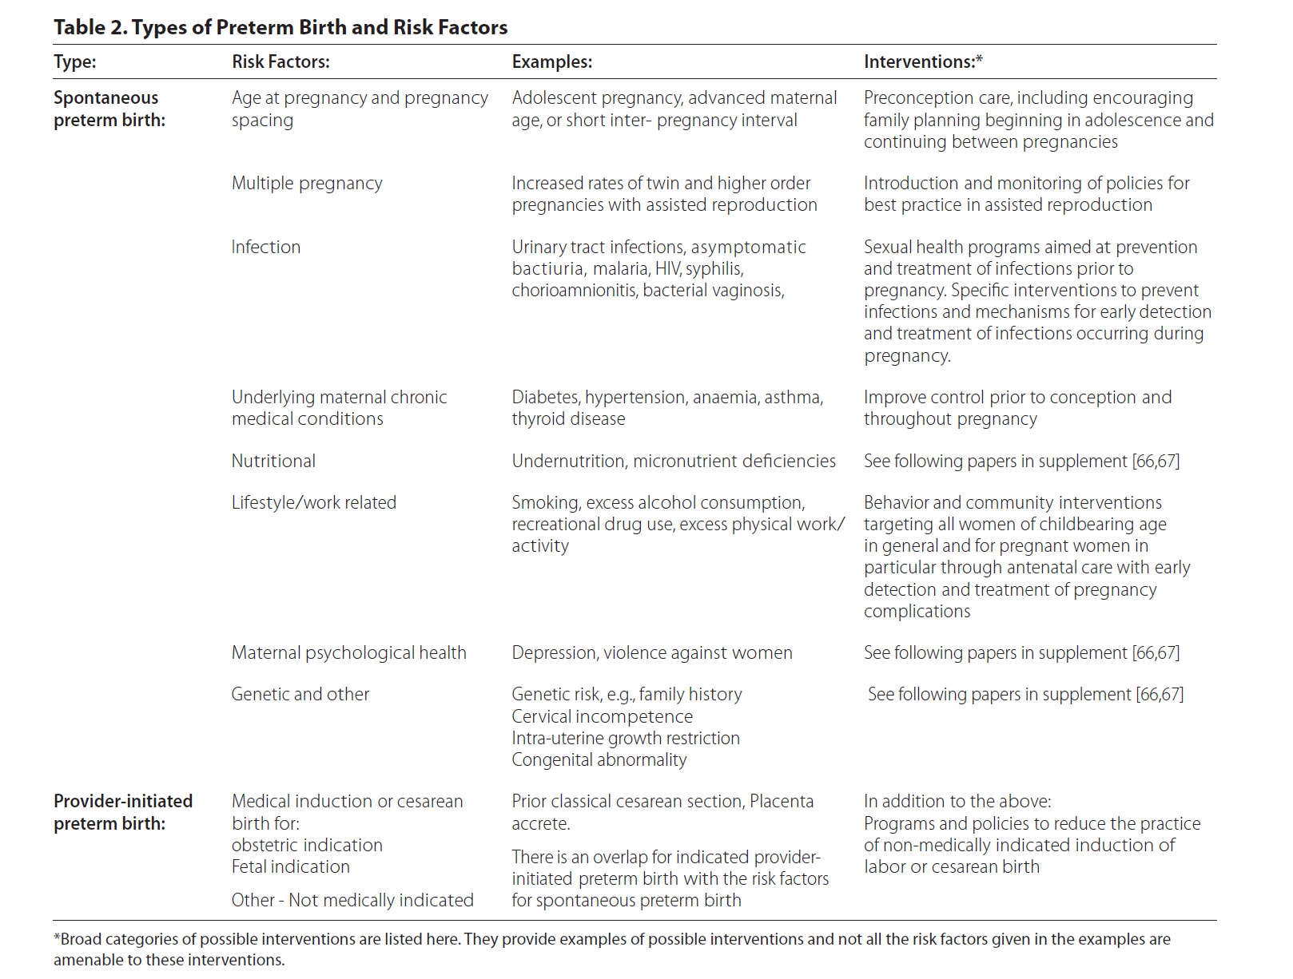
Types of Preterm Birth and Risk Factor
Blencowe et al. Reproductive Health 2013, 10(Suppl 1):S2

Slide 15
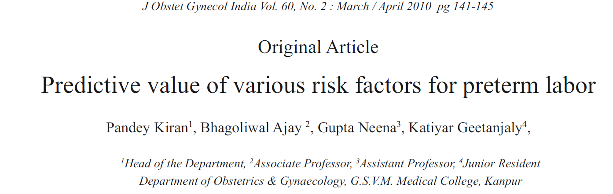
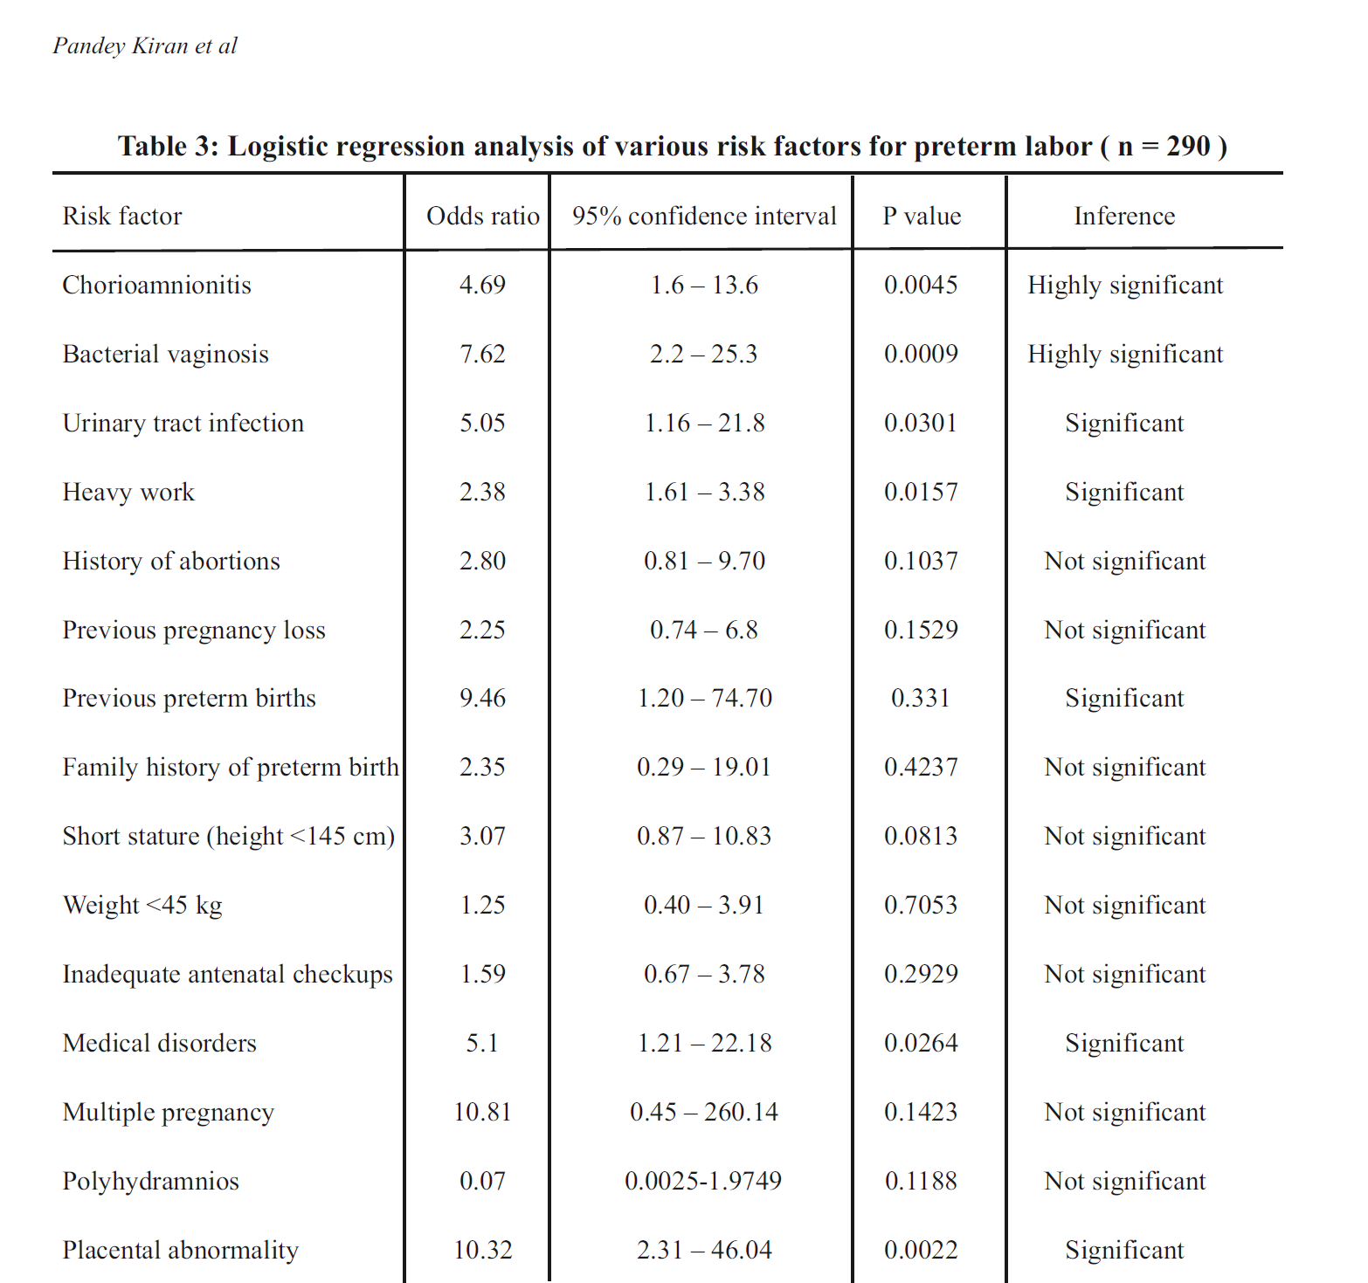

Slide 16
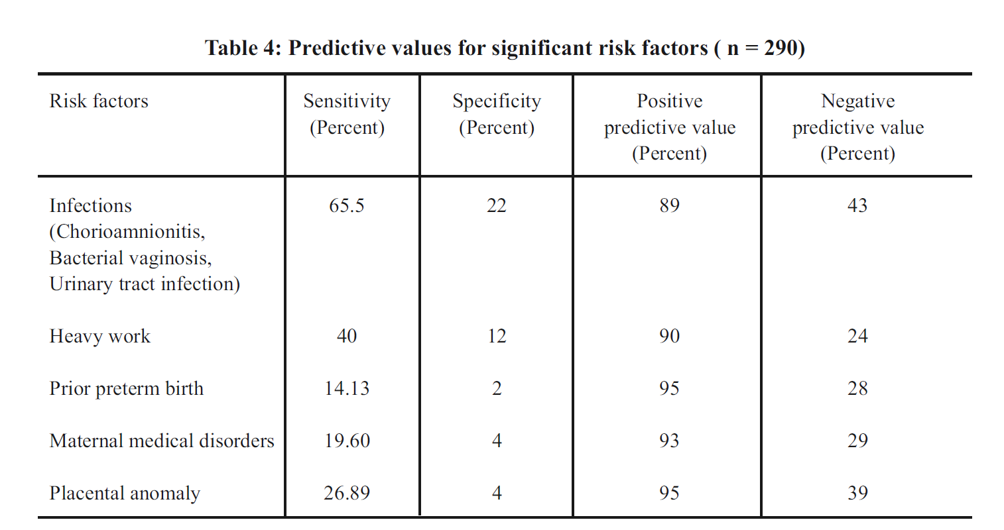

Slide 17

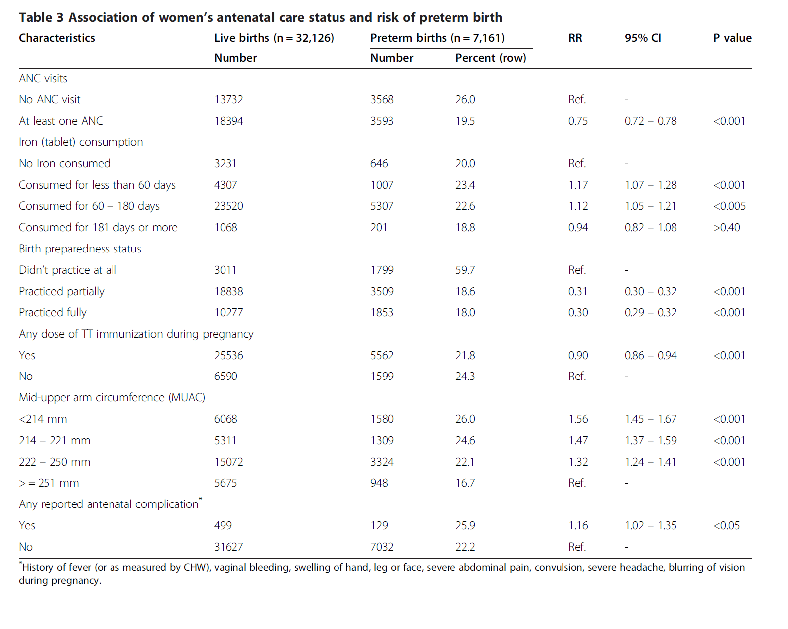

Slide 18
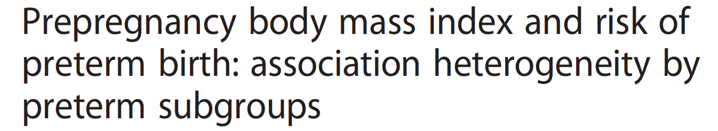
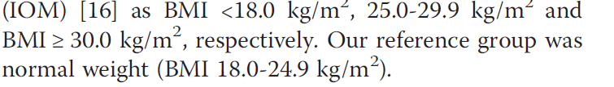
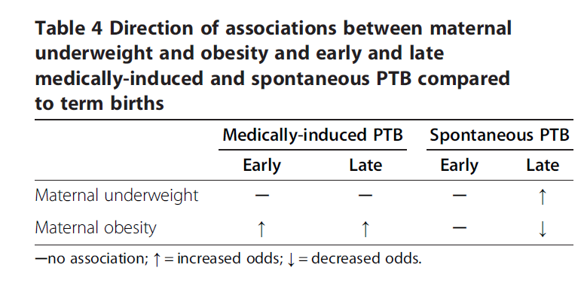


Slide 19
Causes
Not Completely understood
Considered as a syndrome initiated by multiple mechanism or multiple pathway
PTB, categorized either indcated or spontaneous
40% : Idiopathic, 35 % PROM, 25 % Indicated
Dramatic increase over the past 20 years,particularly Indicated and Near term PTBs ( E/ ART,multiple births,woman over 35 year etc) ( Raquij0,2010)

Slide 20
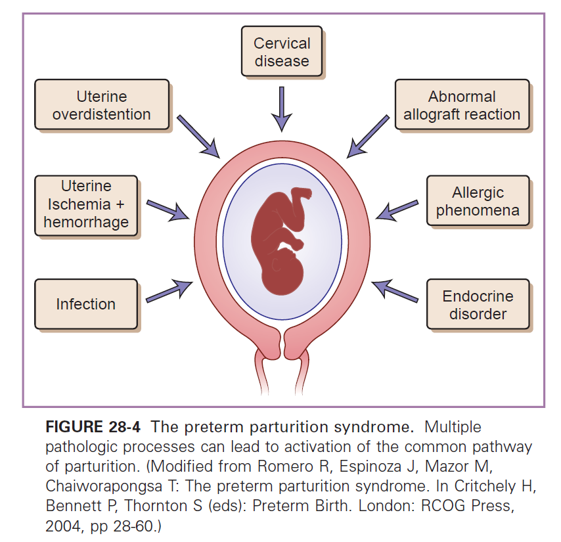
The Preterm parturition syndrome
GENETICS- ENVIRONMENT INTERACTION→ SYNDROME

Slide 21
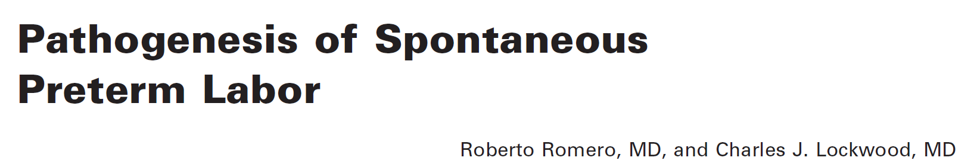
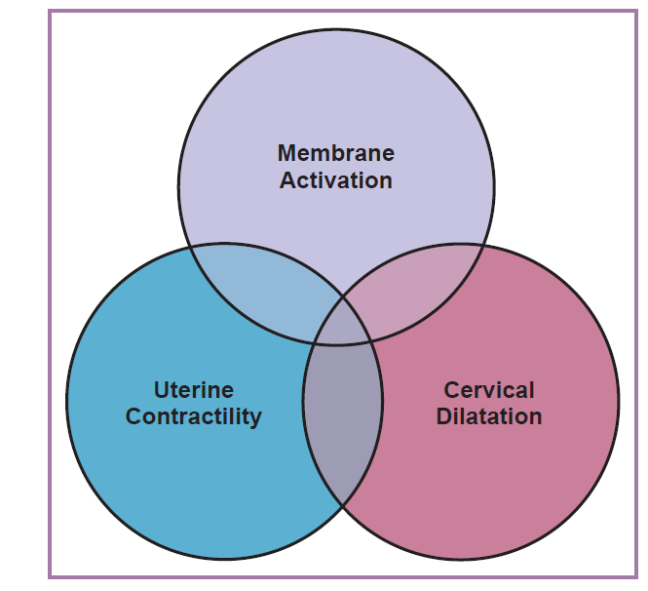


Slide 22
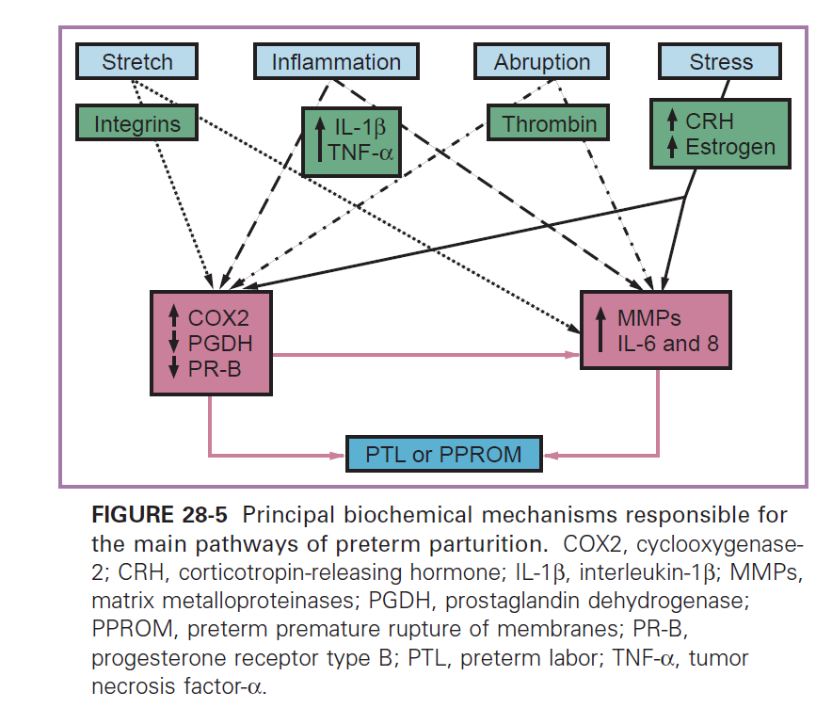
FOUR MAIN PATHWAY OF PRETERM LABOR

Slide 23
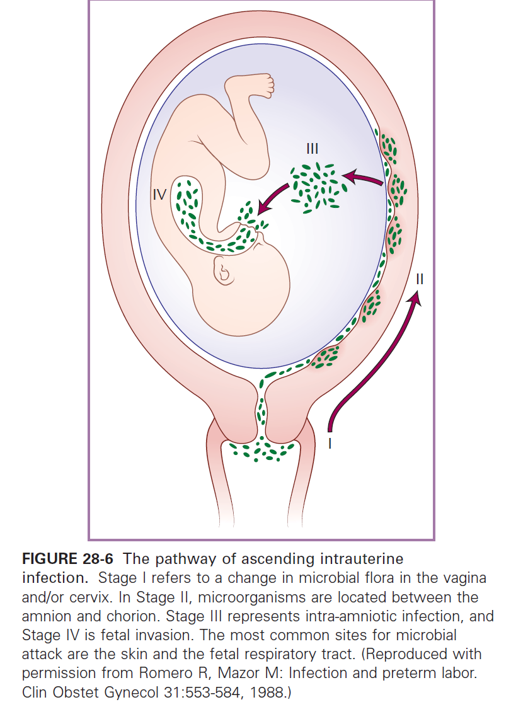
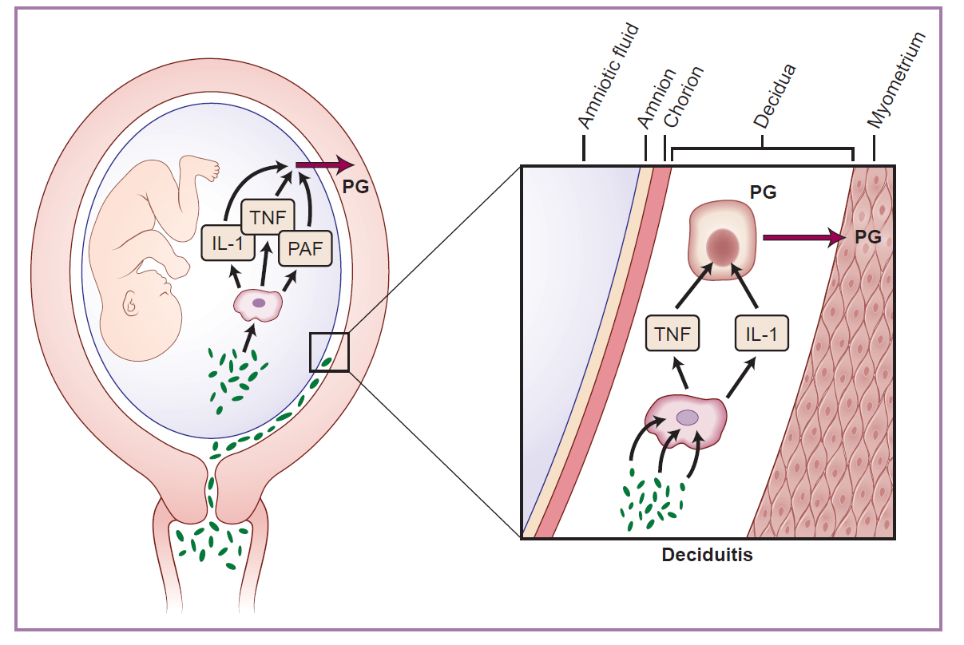
INFECTION- PTL
The Evidences :
Intrauterine infection or admisnitration of microbial product to pregnant animals→ PTL/PTB
Extrauterine maternal infection(malaria,pyelonephritis,periodontal diseases,penumonia)→assciated with PTL
Subclinical intrauterine infetion→ associated PTL
Intraamniotic infection→associated PTL
Antibiotics treatment→ prevent PTL
Treatment of asymptomatic bacteriuria→ prevent PTL

Slide 24

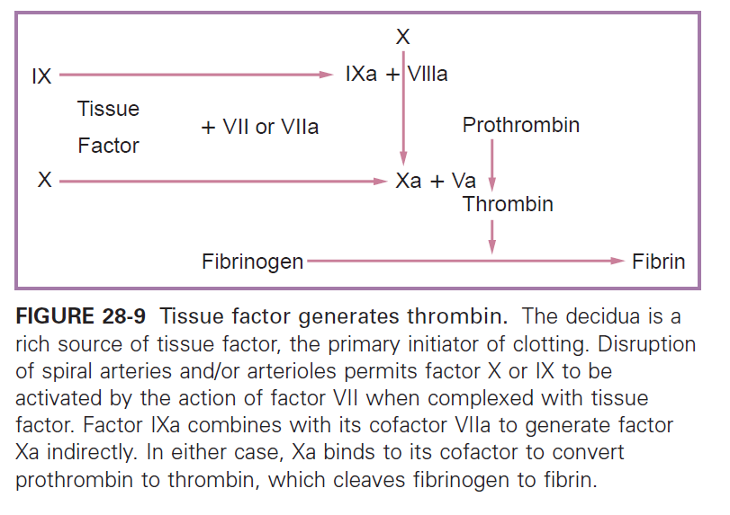
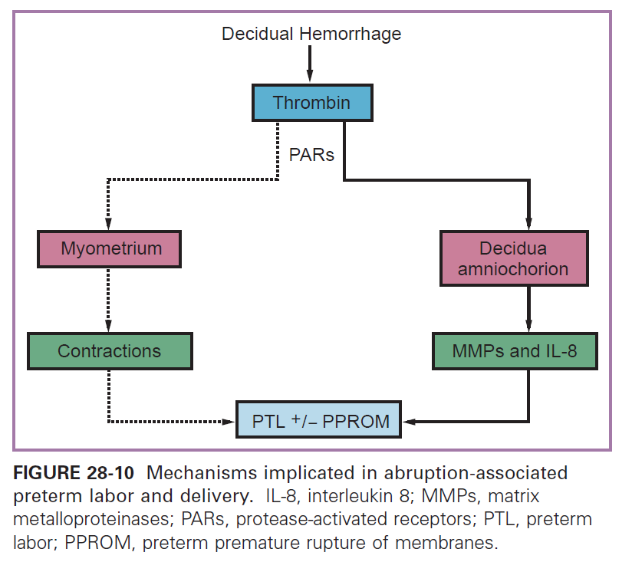

Slide 25

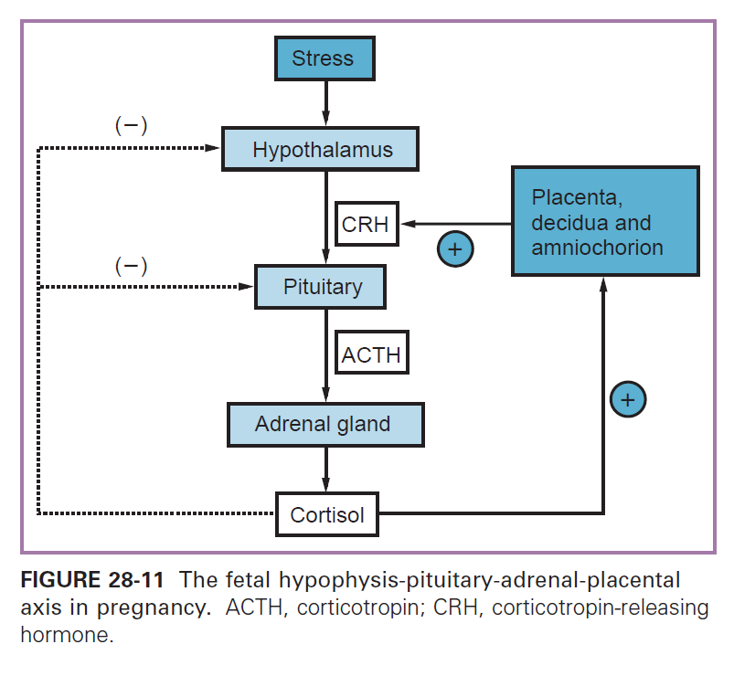
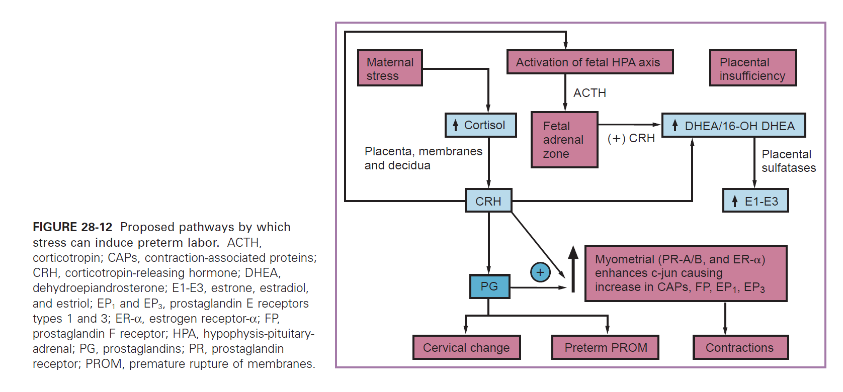

Slide 26

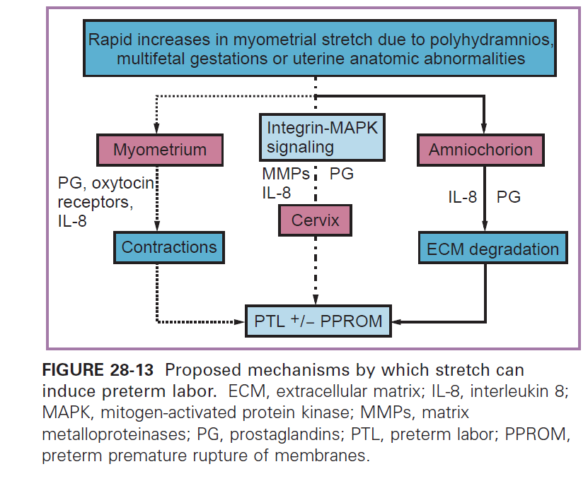

Slide 27




Slide 28
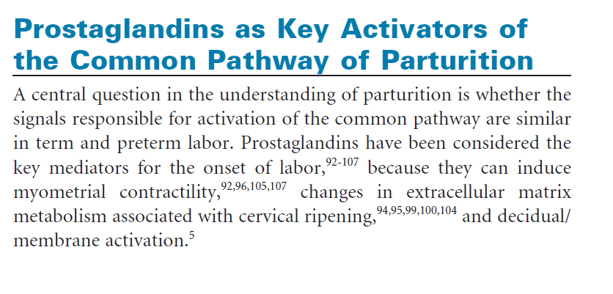
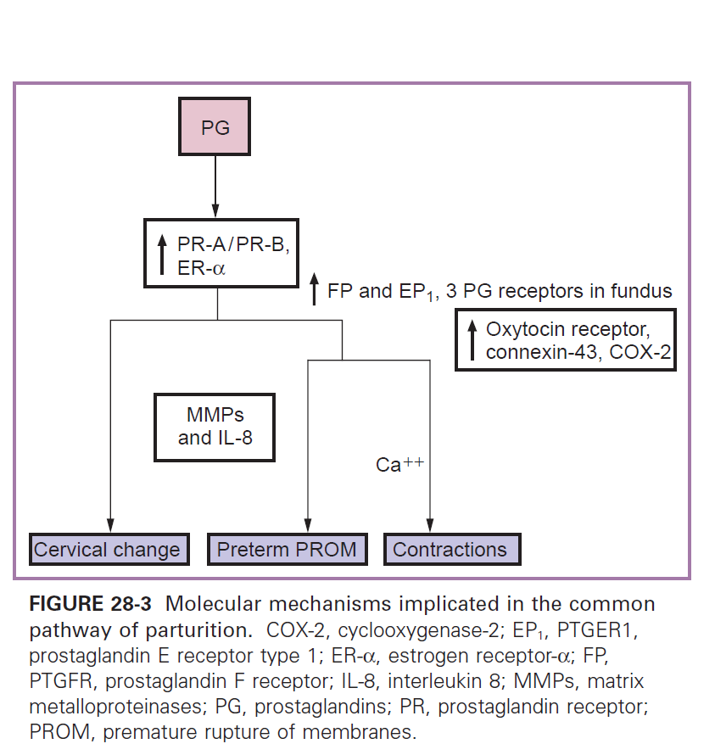

Slide 29
SCREENING FOR SPONTANEOUS PRETERM LABOR AND DELIVERY
Early detection : Problematic due to symptomps & signs vary, multi risk factor
-Criteria : Increasingly and painfull contratction with progressive effacement and dilation of the cervix → uterne contractions = 1x/10 minute, eff 80%, Cx dilation 3cm
The 4 proposed screening tools ( Ogle, et al 2010)
Monitoring of uterine activity
Assesment of cervical length
Measurement of fetal fibronectin
Presence of bacterial vaginosis in early pregnancy

Slide 30
Monitoring uterine activity
Identify pregnancy at risk of PTB
Method :
Subjective :Educate patient palpate and record the contractions for one hour-twice daily → poor Sn ( 85% women palpating less than 50% of their contraction ), time consuming,potentialy increase stress.
Objective : tocography→ 4 contractions/hour
Daily ambulatory home uterine monitoring (hgih risk patients)
Depend on : mother position,tension on the belt,skin thickness
Reduce PTB 25%
Sn 64% and Sp 85%

Slide 31
Cervical Screening
Normal : Cx eff > 32 weeks
PTB : Cx eff 16- 24 weeks
Effacement begins at internal os ( cervical shortening and funneling)→ cervical dilation of external os
Assesment of cervical length and or funneling→ effective screening methods to screen PTB
Transvaginal USG – free from abominal thickness, VU filling ,etc
Screen (+) cutt of < 2,5cm ( 24 weeks)
Asmptomatic High Risk = every 2 weeks , 16-30 weeks
Asymtomatic Low risk = no need
Symptomatic : use transvaginal USG
Twin pregnancy : high rsik to PTB

Slide 32
Cervicovaginal Ffn & Bacterial Vaginosis
Ffn= glycoprotein in AF,placental tissue and decidua basalis
Role in implantaion and placental-uterine attachment→ normal in 16-18 weeks and > 37 weeks
Abnormal : Ffn (+) in 22-37 weeks if found in cervicavaginal secretions→ sign of chorio-decidual interface disruptions.
Likelihood ratio > 5 x for PTB in 7-10 days of testing ( sn 70%,Sp 92%)
Combination Cervical Length + Ffn → Sn 89%.

Slide 33
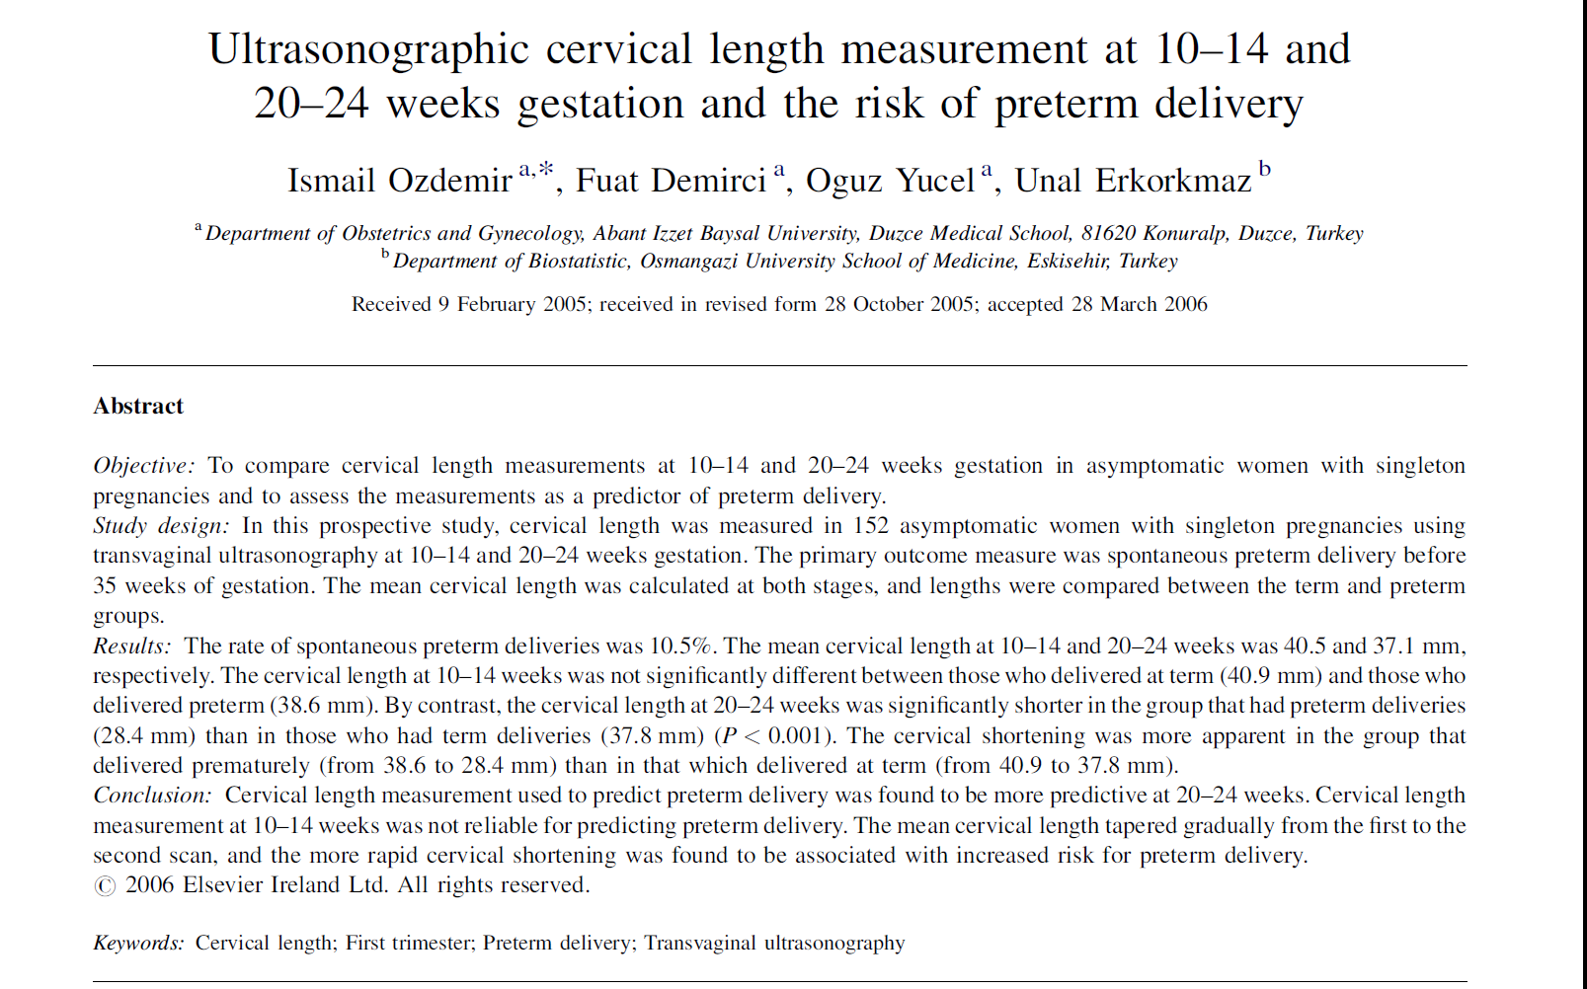

Slide 34
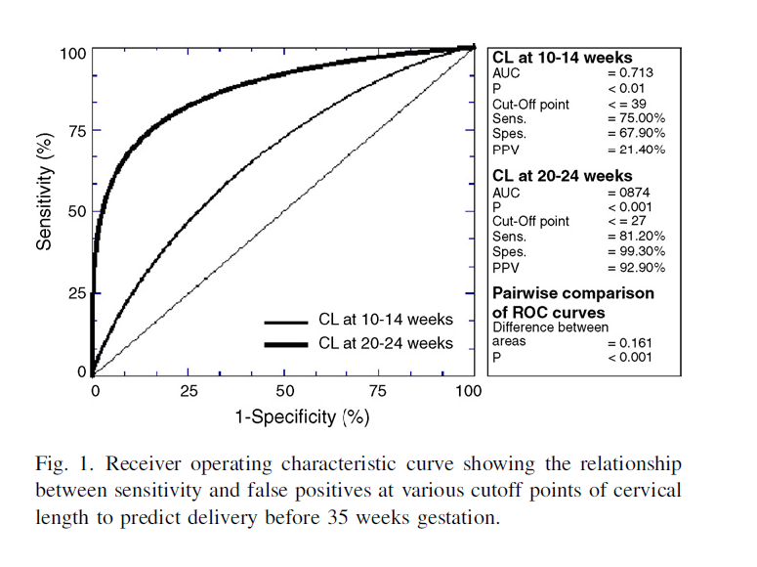
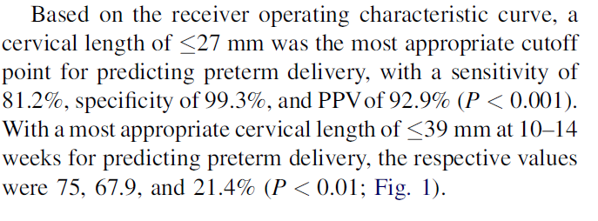

Slide 35
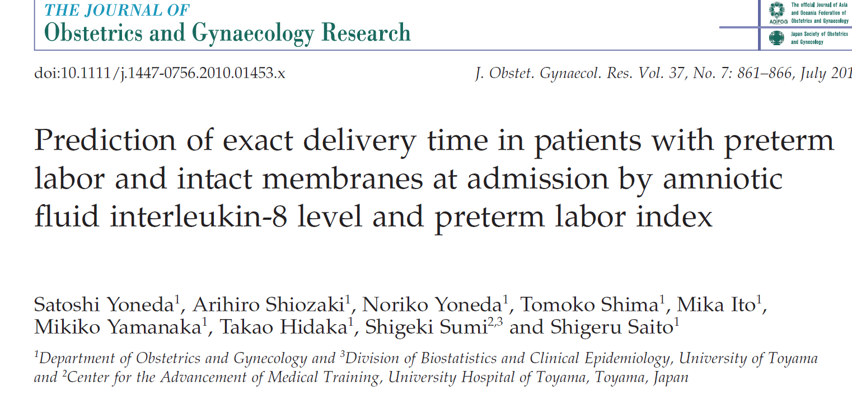
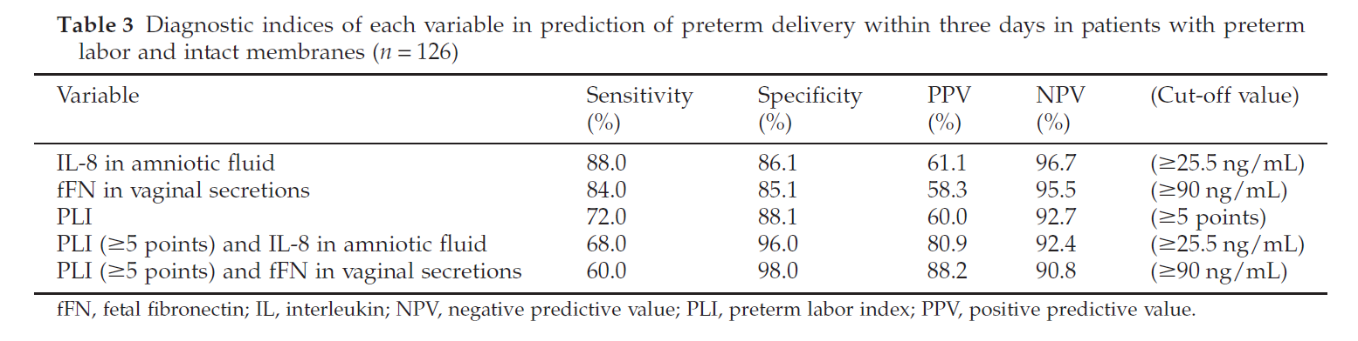
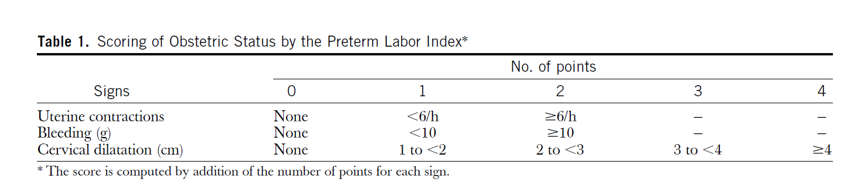

Slide 36
CONCLUSION
THE IMPORTANCE OF RISK IDENTIFICATION → REDUCING PTB
FOCUSED ANC SHOULD BE IMPLEMENTED INSTEAD OF TRADITIONAL ANC
REFERRAL SYSTEM SHOULD BE DEVELOPED→ REDUCE MORBIDITY AND MORTALITY

Slide 37
TERIMAKASIH

